Slide 1

Fund Management Firm using Oracle Database
Nikhil Dharane – 001409173 Kaviya Sachi – 001387786 Varun Senthil – 001434831 Anuja Suryawanshi - 001383812

Slide 2
Purpose of Project
The purpose of this project is to create a database that provides the fund management firm with the strategies to filter their clients based on their portfolio and investment interests in order to propose an optimal investment plan.

Slide 3
Project Objectives
Suggesting different investment plans by using the client portfolio and their past investment trends to fund management firm.
Involve the risk management strategies.
Reducing man-force by building the communication channel through automated emails.

Slide 4
Business Rules
Every Client-Stock proposal should have a unique transaction ID which is used to track the transaction header and all the minor details
Every parameter condition must not be null and should have a certain value within its range associated with it
Based on Stock_Parameter, Evaluation is performed and categorized as High / Moderate / Low
Every Stock_Proposal should be Accepted/Rejected by the client
Every stock is evaluated first and proposed to the client only if the client minimum conditions are met for the stock

Slide 5
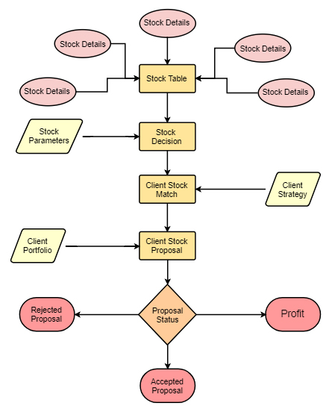
Process Flow

Slide 6
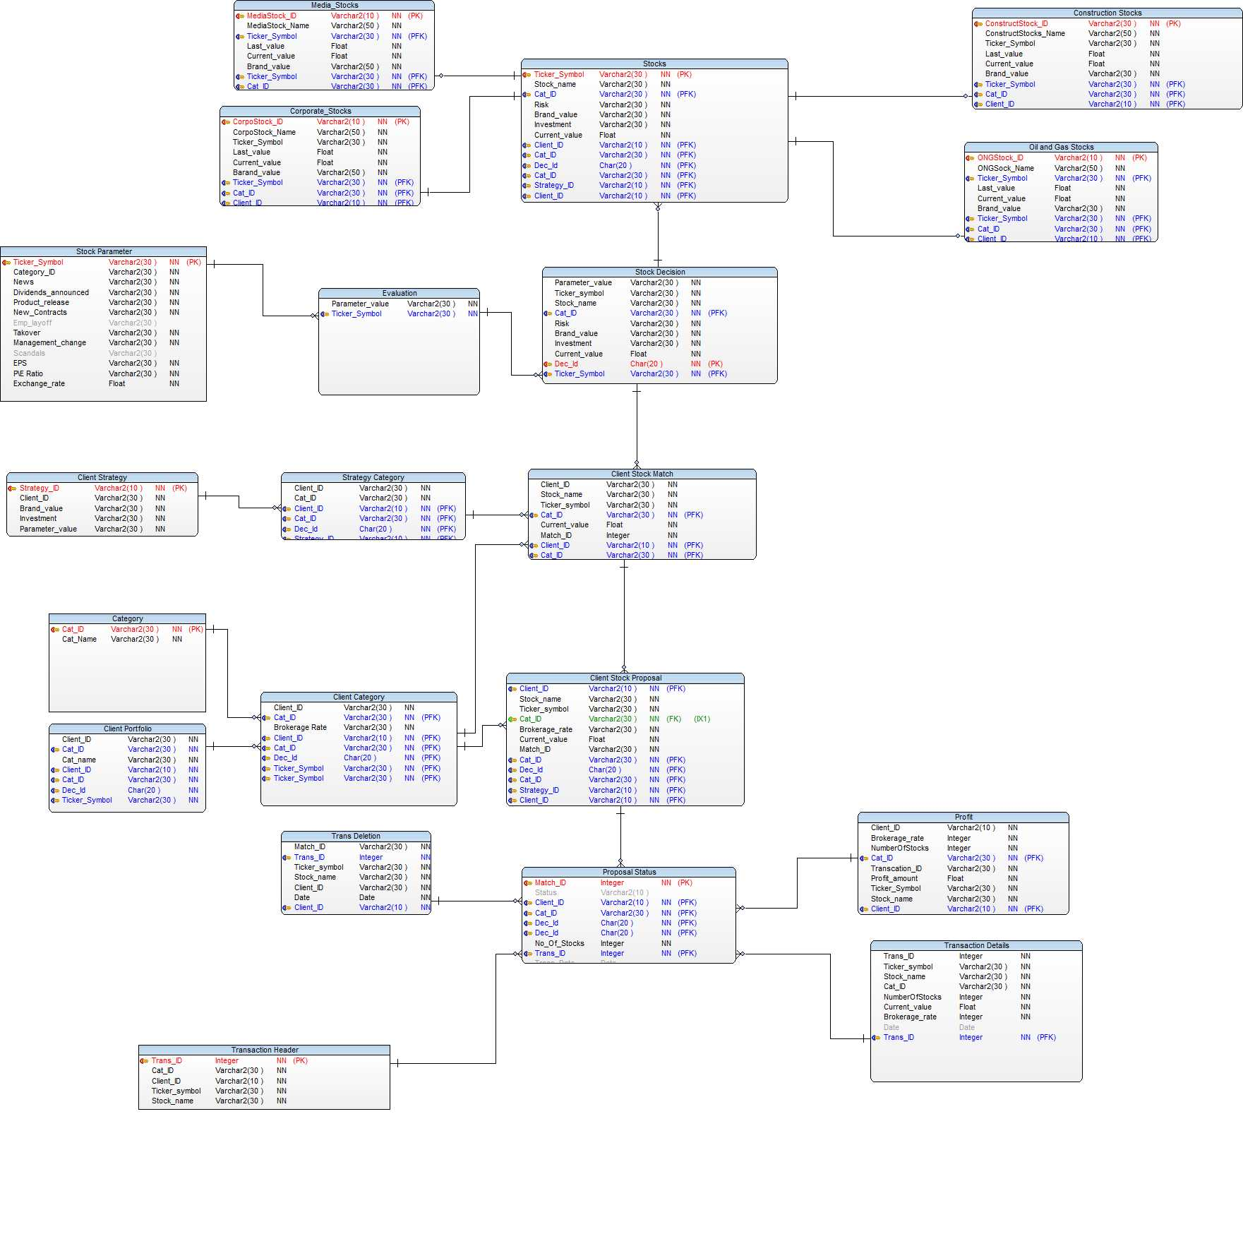
ERD

Slide 7
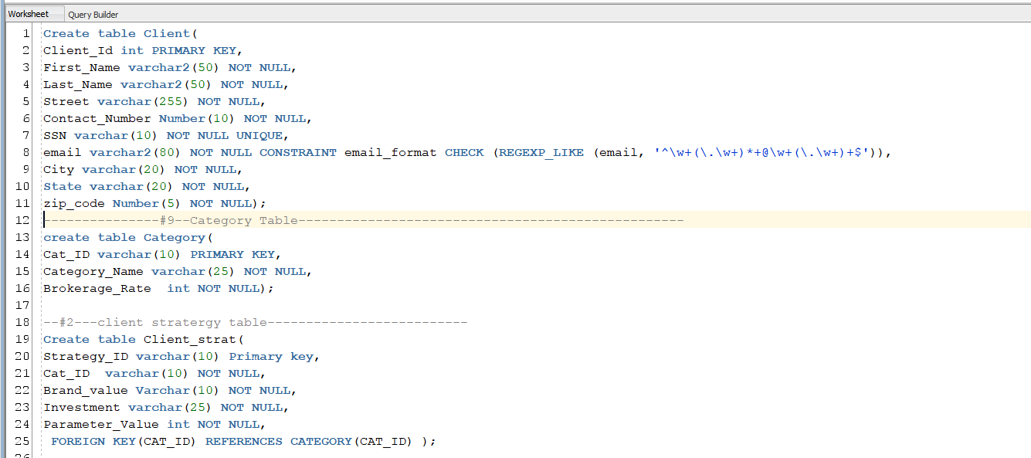
Implementation
Create Tables

Slide 8
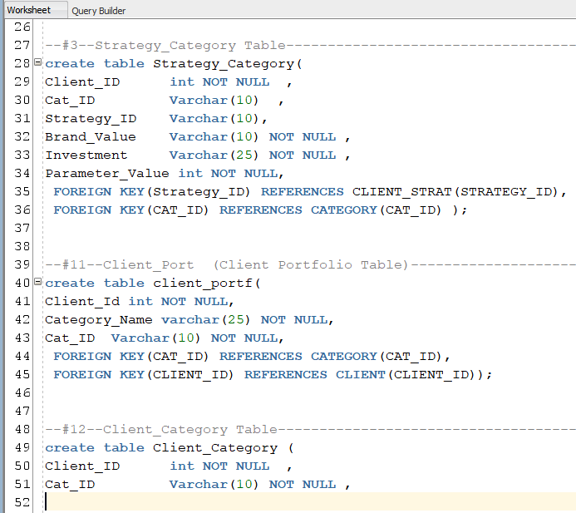
Create Tables

Slide 9
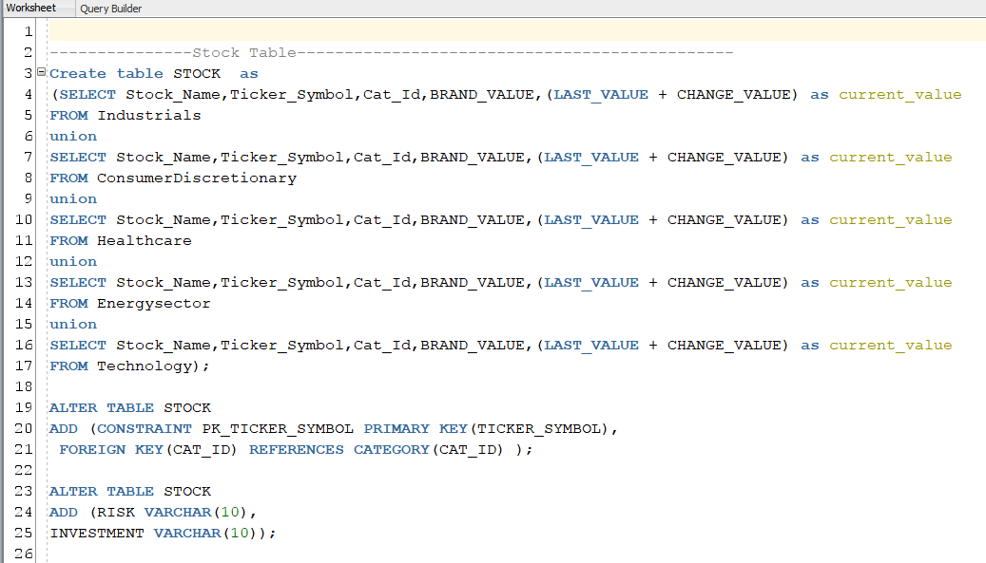
Create Tables

Slide 10
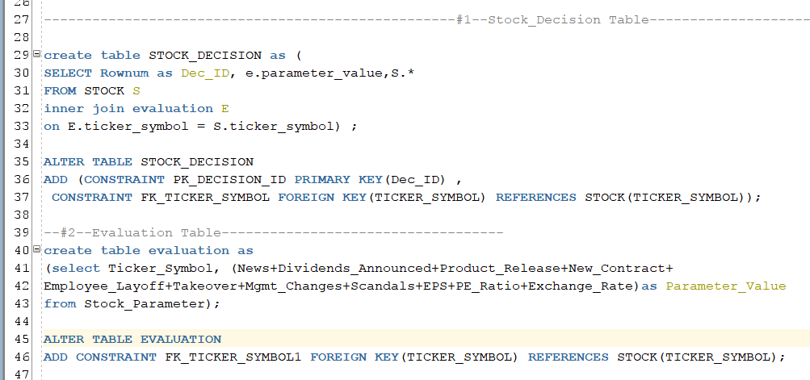
Create Tables

Slide 11
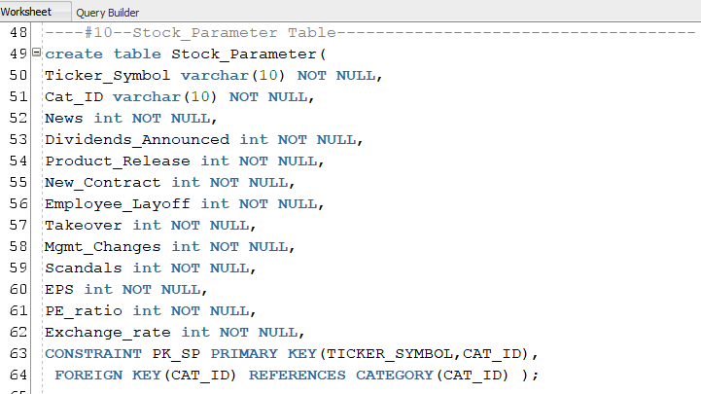
Create Tables

Slide 12
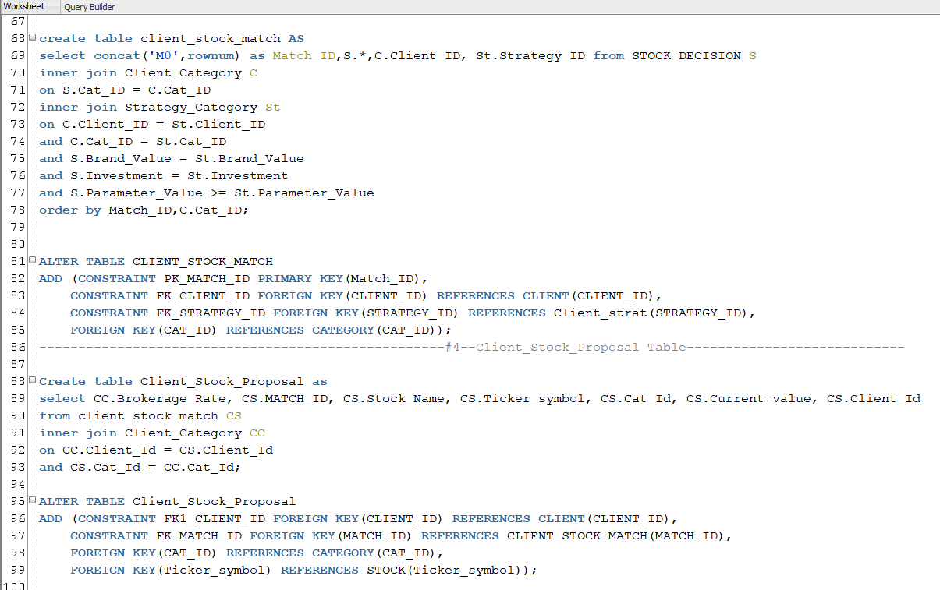
Create Tables

Slide 13
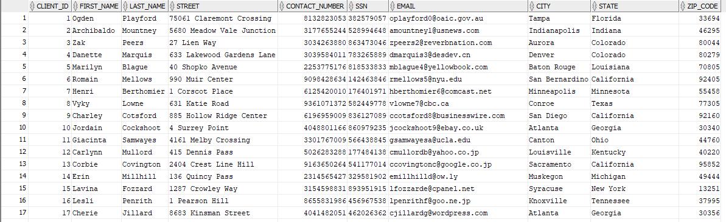
Client Table

Slide 14
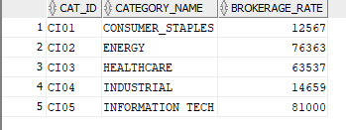
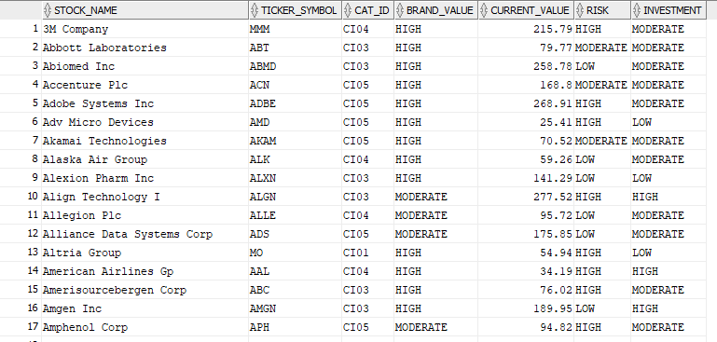
Category
Stock Table

Slide 15
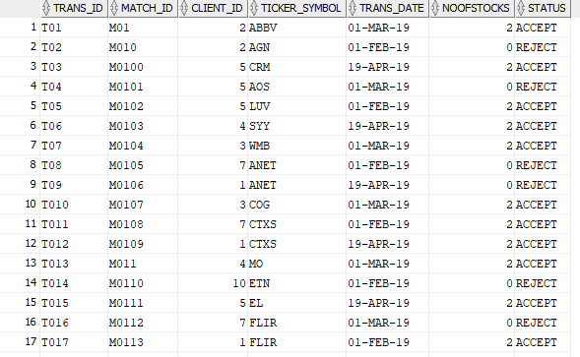
Proposal Status Table

Slide 16
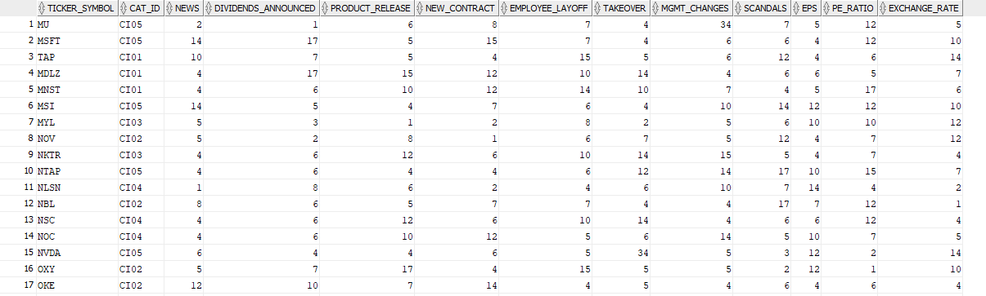
Stock Parameter

Slide 17
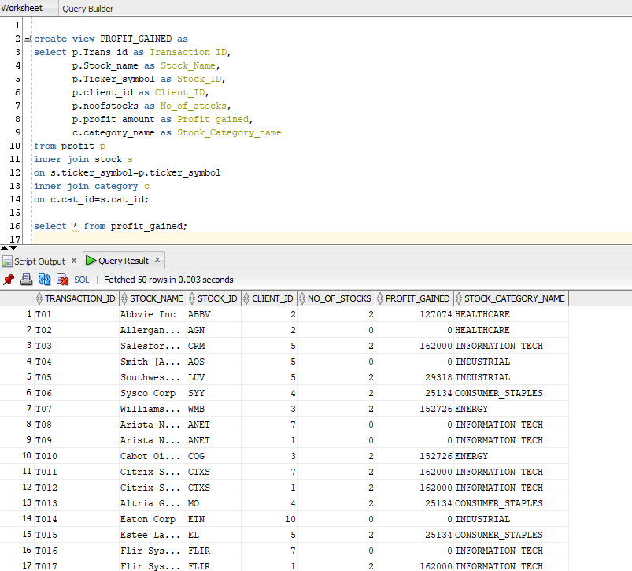
Profit Gained

Slide 18
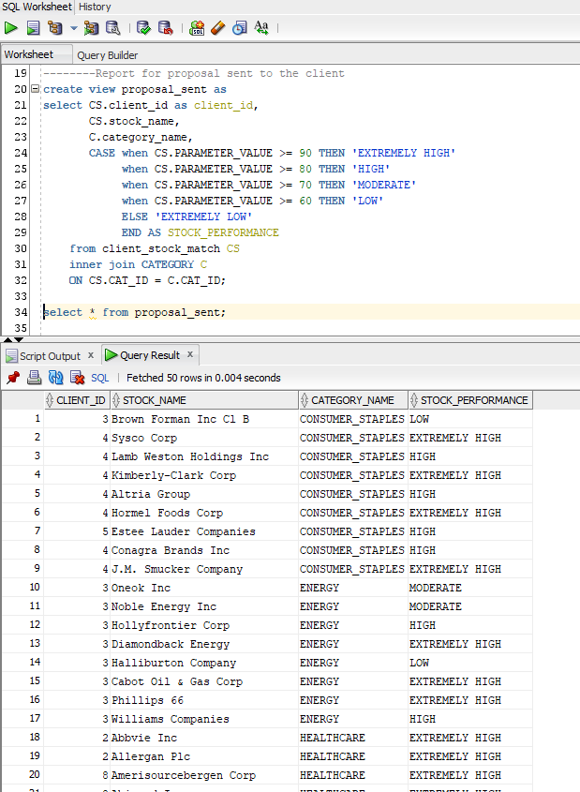
Proposal Sent

Slide 19
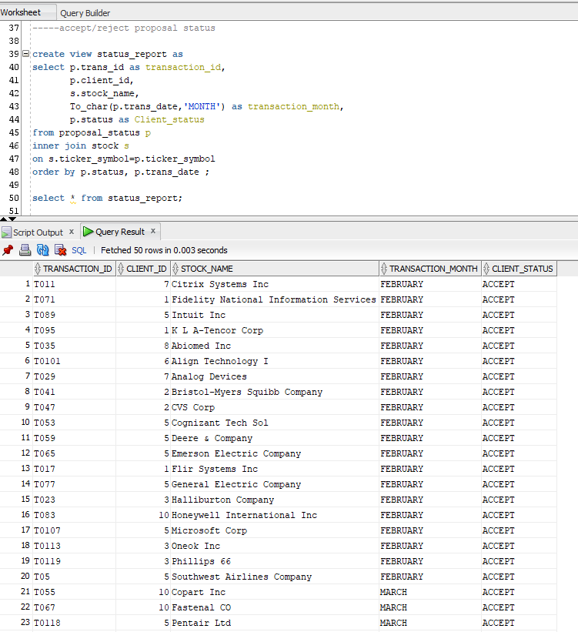
Status Report

Slide 20
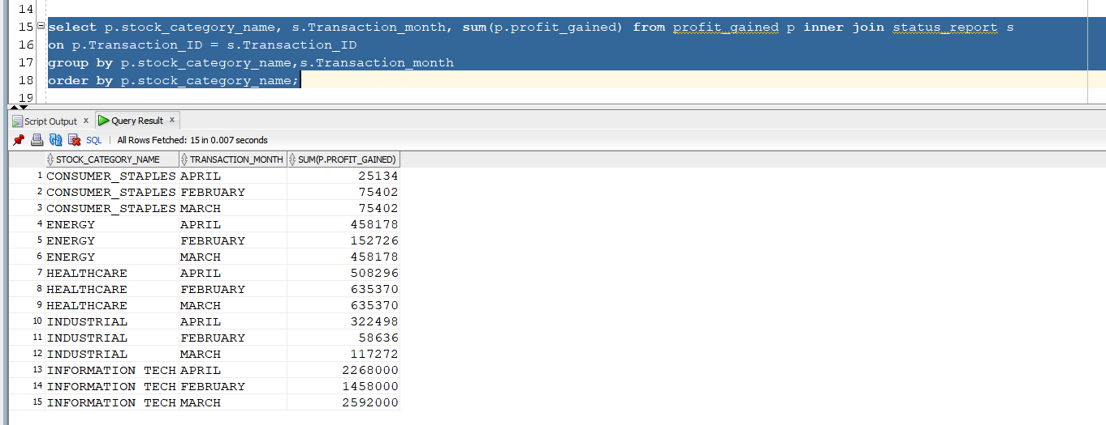
Reports

Slide 21
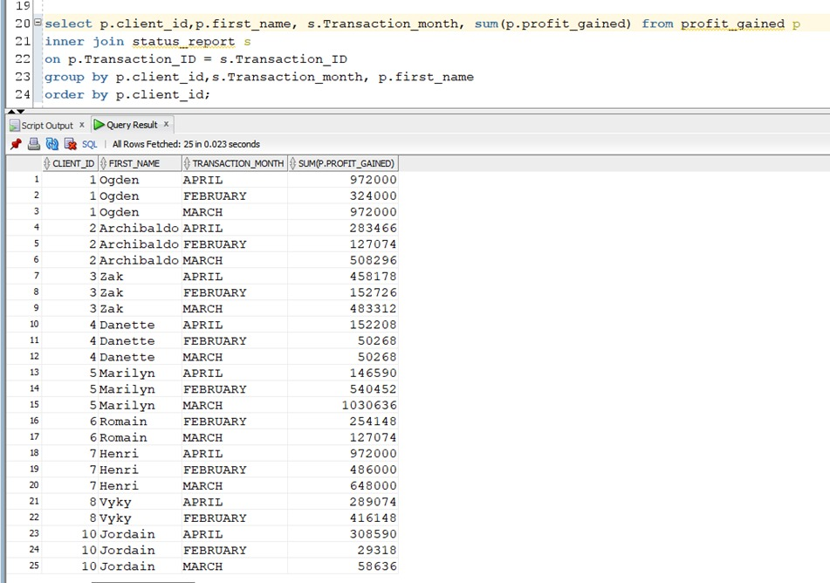
Client Profit

Slide 22
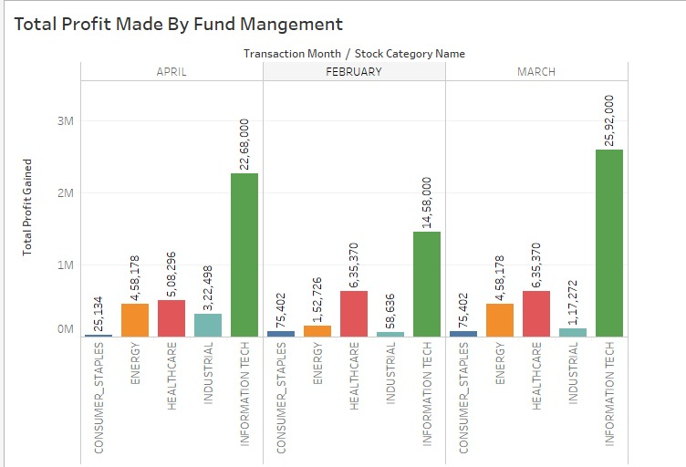

Slide 23
